Slide 1
DATASTRUCTURES AND ALGORITHM

Slide 2
What is Program
A Set of Instructions
Program = algorithm + Data Structure
Data Structure = A Container stores Data
Algorithm = Logic + Control

Slide 3
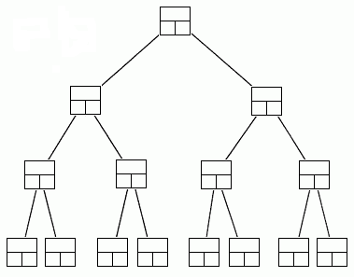
Data Structures
A data structure is a scheme for organizing data in the memory of a computer.
Some of the more commonly used data structures include lists, arrays, stacks, queues, heaps, trees, and graphs.
The way in which the data is organized affects the performance of a program for different tasks.
Computer programmers decide which data structures to use based on the nature of the data and the processes that need to be performed on that data.
Binary Tree

Slide 4
Classification of Data Structure
Data structure
Primitive DS
Non-Primitive DS
Integer
Float
Character
Pointer
Integer
Float
Float

Slide 5
Classification of Data Structure
Non-Primitive DS
Linear List
Non-Linear List
Array
Queue
Graph
Trees
Link List
Stack

Slide 6
TYPES
Dynamic data structures:
Data structures that grow and shrink during execution
Linked lists:
Allow insertions and removals anywhere
Stacks:
Allow insertions and removals only at top of stack
Queues:
Allow insertions at the back and removals from the front
Binary trees:
High-speed searching and sorting of data and efficient elimination of duplicate data items

Slide 7
Core operations
Data Structures will have 3 core operations
a way to add things
a way to remove things
a way to access things
Details of these operations depend on the data structure
Example: List, add at the end, access by location, remove by location
More operations added depending on what data structure is designed to do

Slide 8
The need for data structures
Data structures organize data, this gives more efficient programs.
More powerful computers encourage more complex applications.
More complex applications demand more calculations.
Complex computing tasks are unlike our everyday experience.

Slide 9
organisation
Any organization for a collection of records can be searched, processed in any order, or modified.
The choice of data structure and algorithm can make the difference between a program running in a few seconds or many days.
A solution is said to be efficient if it solves the problem within its resource constraints.
Space
Time
The cost of a solution is the amount of resources that the solution consumes.

Slide 10
Data structure philosophy
Each data structure has costs and benefits.
Rarely is one data structure better than another in all situations.
A data structure requires:
space for each data item it stores,
time to perform each basic operation,
programming effort.
Each problem has constraints on available time and space.
Only after a careful analysis of problem characteristics can we know the best data structure for the task.

Slide 11
Example
Bank account transactions
Open an account: a few minutes
Withdraw from the account: a few seconds
Add to the account: overnight (or more)
Close the account : overnight

Slide 12
Abstract data TYPES
abstract data type (ADT): A specification of a collection of data and the operations that can be performed on it.
Describes what a collection does, not how it does it
Described in Java with interfaces (e.g., List, Map, Set)
Separate from implementation
ADTs can be implemented in multiple ways by classes:
ArrayList and LinkedList implement List
HashSet and TreeSet implement Set
LinkedList , ArrayDeque, etc. implement Queue
Java messed up on Stack—there's no Stack interface, just a class.

Slide 13


